Slide 1
Procedural Sedation and Analgesia
The Pediatric Patient

Slide 2
Pediatric Procedural Sedation Course Content
SNHMC policy and guidelines
Regulatory requirements
Pre-procedure planning
Conduct of pediatric sedation
Pharmacology of sedative agents
Patient safety & outcomes

Slide 3
Pediatric Procedural Sedation
Who are the interested parties involved in credentialing pediatric moderate sedation?
Regulatory bodies
NIAHO-DNV-GL
The Joint Commission
Centers for Medicare and Medicaid (CMS)
Institutional policy
Academic framework
American Society of Anesthesiologists
American Academy of Pediatrics

Slide 4
Pediatric Moderate Sedation
What is expected from the credentialing process for moderate sedation privileges?
Leadership from anesthesiologists
Uniform processes / consistent standards of care, regardless of:
Patient age
Procedure
Location
Provider
Effective & reliable system of rescue
Institutional sedation safety and efficacy

Slide 5
SNHMC Procedural Sedation Policy
Covers the following information:
Key definitions:
Moderate Sedation
Core competencies for providers
specialized knowledge in procedural sedation for pediatric population
experiential components: airway management demonstration or current certification in recognized life support program (PALS)
Procedural requirements for providers
Airway assessment, ASA risk assignment, patient assessment, administration of medications, monitoring, recovery, & discharge

Slide 6
Goals and Objectives
Goals of Procedural Sedation:
Enhanced patient cooperation
Decreased patient movement
If the procedure requires that the patient does not move at all, consider an anesthesia consult as procedural sedation does not provide for this
Amnesia (not guaranteed)
Rapid recovery
Maintain adequate sedation with minimal risk
Relieve anxiety
Provide relief from pain and other noxious stimuli

Slide 7
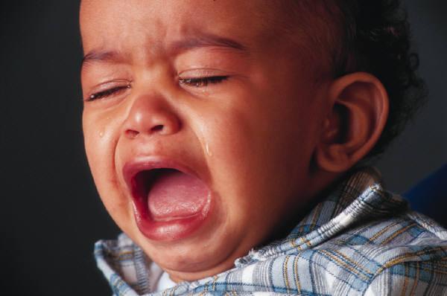
What is the intent of procedural sedation?
Reduction of fear, anxiety, & stress
Provision of comfort, safety, and a sense of well-being
Cooperation during procedure to allow its completion
Alteration of memory or amnesia
Provision of pain control

Slide 8
The Myth of Moderate Sedation
MYTH:
Complete immobility/absence of pain can be achieved
False:
To meet that request, you need:
Deep sedation
Anesthesia

Slide 9
Consider the following:
In the pediatric population:
To meet necessary goals, sedation/analgesia usually must be deeper than given to adults.
Due to physiologic differences, children are at higher risk for respiratory depression and life-threatening hypoxia.
Technically, “moderate sedation” may be closer to the definition of “deep sedation” because children can easily slip from one level to another.

Slide 10
Continuum of Sedation: Consider: it is easy for a child to slip from one level to the next despite the original plan and intent
anxiolysis
Moderate
Sedation
Deep Sedation
General Anesthesia
Potential loss of airway
Protective reflexes
Respiratory depression
CV collapse

Slide 11
What is expected of the provider vis-à-vis procedural sedation?
During the administration of sedatives it expected that the provider:
be physically present with the patient
be aware of the patient responses as they monitored by the nurse during the administration of the medications and during the procedure

Slide 12
What is expected of the provider during procedural sedation?
You must remain “immediately available”, that is you cannot leave the area or be engaged in any other un-interruptable activity or task
You must know how to
Rescue from over-sedation
support the airway with BVM ventilation
stabilize hemodynamics

Slide 13
Documentation Responsibilities: Provider
Informed consent for sedation
History and Physical completed in chart
Pre-sedation assessment
Includes ASA assignment and airway classification
Time-out signed
Medication orders signed
“special procedures” note complete
Verify recovery/discharge criteria met
Officially discharge patient from moderate sedation

Slide 14
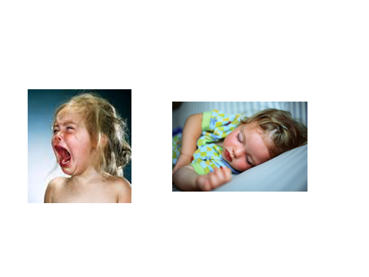
Patient Considerations

Slide 15
Patient Considerations
Current Medications?
Drug allergies?
Results of diagnostic tests / labs?
LMP? pregnant?
Prior response to sedatives or anesthetic agents?

Slide 16
Patient Considerations
Chronologic and developmental age
Baseline level of responsiveness
Baseline vital signs
Anxiety / cooperativeness of patient
Focused physical exam
Risk for loss of protective reflexes, airway obstruction, cardio-pulmonary or neurologic decompensation
Patient Considerations

Slide 17
Does the child have medical issues that could put him or her at increased risk for complications?
Recent upper respiratory illness symptoms, especially coughing, wheezing, or nasal congestion, can increase the risk of airway irritability and respiratory complications, including hypoventilation, desaturation, and laryngospasm.
Similarly, a history of recent vomiting or symptomatic gastroesophageal reflux can be cause for concern, as emesis during sedation, when airway protective reflexes may be blunted, could lead to aspiration and initiate laryngospasm.
Significant obesity, an increasing problem in the pediatric population, may be associated with an increased risk of airway obstruction, especially with deeper levels of sedation.
Overt obstructive sleep apnea symptoms are clearly associated with airway obstruction during sedation; however, many families are unable to say how frequently or how badly their children snore. Even occasional audible snoring makes the need for airway repositioning and nasopharyngeal airway placement more likely

Slide 18
Pediatric Medical Problems
Developmentally delayed patients frequently have a less predictable response to effects of sedation/analgesia
Hypertrophied tonsils/adenoids increase risk of airway obstruction while sleeping
Elective cases should be postponed if any of the following are present:
Croupy cough
Significant temperature
Significant sign of URI
Malaise/decreased appetite
Evidence recent lower resp infections (rales, wheezes, productive cough)

Slide 19
Patient Considerations: What’s crucial in the airway evaluation?
known difficulty
mouth opening
nares patent
tongue size and mobility
neck mobility, especially in extension
recessed chin or micrognathia
cranio-facial anomalies
airway malacias
adeno-tonsillar hypertrophy
obesity
Obstructive sleep apnea
Note: many syndromes have airway issues

Slide 20
Mallampati Airway Assessment
Mallampati airway classification predicts high risk or difficult airways (Class III or IV warrant consultation with an anesthesiologist)

Slide 21
ASA Physical Status Classification System
PS 1 - normal healthy patient
PS 2 - patient with mild systemic disease, no functional limits
PS 3 - patient with severe systemic disease, some functional limits
PS 4 - patient with severe systemic disease that is a constant threat to life
PS 5 - patient not expected to survive for 24 hours with or without the procedure
These definitions appear in each annual edition of the ASA Relative Value Guide.® There is no additional information that will help you further define these categories.

Slide 22
NPO Guidelines
Although the need for strict NPO guidelines for urgent and emergent sedations continues to be a topic of debate, most physicians should plan to adhere to the recommended ASA guidelines.
These suggest the following NPO times:
Clear liquids—two hours
Breast milk—four hours
Infant formula, other nonhuman milk, solids—six hours
Full meal—eight hours

Slide 23
NPO Guidelines
*For children requiring sedation who do not meet the ASA NPO guidelines, recommended options include delaying the procedure or consulting anesthesia
*urgency of the situation is considered

Slide 24
What leads to sedation problems?
Combinations of meds
Poor patient selection
Incorrect drug dosing
Lack of appreciation of drug interactions
Lack of or inadequate monitoring before, during and after sedation

Slide 25
Procedure-Related Considerations

Slide 26
Procedure Related Considerations
First, determine your needs:
Sedation?
Anxiolysis? Amnesia?
Analgesia?
Immobility?
ALL of these?

Slide 27
Planning Procedural Sedation in Pediatric Population
When planning sedation and/or pain management for a child, knowing what level of responsiveness needs to be achieved during the procedure or test is essential for choosing the appropriate medication regimen.
Painful procedures that require relative immobility generally mandate a deeper level of sedation than noninvasive radiological tests.
Each sedation plan should take into account the age, developmental level, and personality of the child.

Slide 28
Monitoring the sedated child
Continuously monitored parameters
Adequacy of ventilation / oxygenation
Hemodynamic stability
Level of consciousness / responsiveness

Slide 29
Monitoring ventilation and oxygenation
Ongoing assessment for adequacy of ventilation and oxygenation includes
Airway patency
Rate, depth, & pattern of ventilation
Oxygenation through pulse oximetry
Ventilation via observation of chest rise, rate and ETCO2 monitoring

Slide 30
Monitoring the sedated patient
Recognizing airway obstruction:
Snoring
Falling O2 sats
Retractions
Laryngospasm
Scary silence or Deadly Quiet
Absent or ↓ exhaled CO₂
Relieving airway obstruction:
“Sniffing” position
Shoulder roll
Jaw lift
Nasal airway
Consider need to reverse
Consider need to call anesthesia for assistance

Slide 31
Monitoring the sedated patient
Hemodynamic stability:
heart rate
non-invasive blood pressure
electrocardiography (EKG)- 3 lead monitoring

Slide 32
Monitoring the sedated patient
Level of consciousness (LOC)
responds to verbal command?
responds to tactile stimulus?
protective reflexes intact?
pain assessment (as appropriate)
*reflex withdrawal to pain is not considered a purposeful response

Slide 33
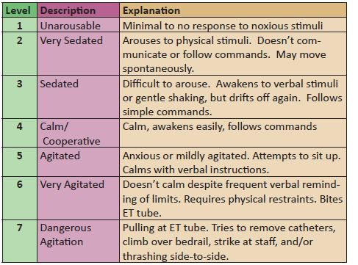
We use the Riker Sedation Scale for LOC assessment:

Slide 34
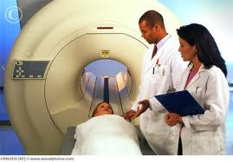
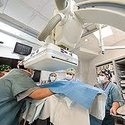
Personnel Considerations

Slide 35
Personnel Considerations
Level of experience for this procedure
Availability of staff & equipment for:
patient transport
administration of sedation & monitoring
rescue / resuscitation
recovery

Slide 36
Personnel Requirements:
Support personnel:
At least 1 person dedicated to the patient to constantly monitor appropriate physiologic parameters and assist in any supportive or resuscitation measures
Be trained in, and capable of providing, pediatric basic life support
Know how to use resuscitation equipment & supplies in the event of an emergency

Slide 37
Strategies for successful sedation practice in pediatrics
Outcomes improve when services are provided by dedicated, appropriately configured, and experienced teams using clear guidelines / protocols

Slide 38
Strategies for successful sedation practice in pediatrics
Choose single-agent regimens for non-painful, non-invasive imaging studies, and reserve combination regimens for procedures which require both analgesia and sedation.

Slide 39
Strategies for successful sedation practice in pediatrics
CONSIDER RISKS:
combining sedative / hypnotics or general anesthetics with opioids significantly increases the risk for:
loss of airway
hypoventilation
hypoxia
bradycardia

Slide 40
Strategies for successful sedation practice in pediatrics
Non-pharmacologic techniques can reduce the need for extreme doses of drugs:
guided imagery
music / distraction / videos in MRI
relaxation techniques
parental presence
calm atmosphere and personnel

Slide 41
Strategies for successful sedation practice in pediatrics
Titrate frequent, appropriate doses at appropriate intervals when using potent intravenous sedatives and analgesics.
Be patient and give agents time to work!
Reduce initial doses when combining agents of different classes.

Slide 42
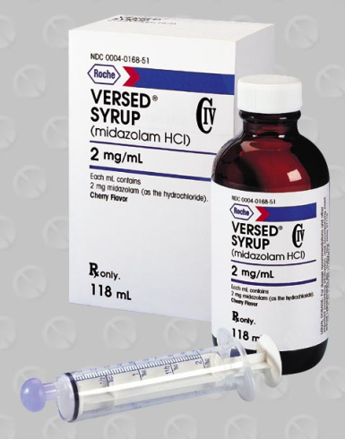
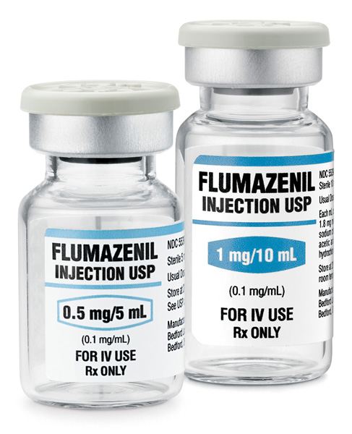
Commonly Used Medications

Slide 43
Medications
Benzodiazepines
Versed/midazolam
Sedative/anxiolytic/amnesic
Paradoxical reactions (1-2% of population may experience this)
Inconsolable crying
Combativeness
Disorientation
Dysphoria
Tachycardia
Agitation
restlessness

Slide 44
Medications
The following medication information is taken directly from SNHMC’s Policy and Procedure manual.
It is the responsibility of the ordering provider to individualize the dosing and timing of medications to meet the patient’s needs.
It is the responsibility of the provider ordering the medications to be familiar with their actions, indications, method of administration, contraindications, precautions, adverse reactions and management of the drugs’ complications.

Slide 45
Medication | Initial Dose | Repeat Dose | Techniques of Administration
Midazolam IV (Versed) Class Benzodiazepine Anesthetic Adjunct | 6 months-5years 0.05 - 0.1 mg/kg 6 years- 11years 0.025 - 0.05 mg/kg 12years-18years 0.5 – 2mg each dose | May repeat specific dose every 5 minutes per pediatric procedural sedation order set if Riker’s Scale score=5 to MAX of 6mg May repeat specific dose every 5 minutes per pediatric procedural sedation order set if Riker’s Scale score=5 to MAX of 10mg May repeat specific dose every 5 minutes per pediatric procedural sedation order set if Riker’s Scale score=5 to MAX of 10mg | Give: each dose slowly over 2 minutes (Onset 3-5 minutes). Subsequent doses in age appropriate increments. Wait: an additional 5 or more minutes after each increment to fully evaluate the sedative effect Repeat: Titrate with age appropriate doses to the appropriate level of sedation Total doses: see maximum doses by age Duration: 1-5 hours in healthy patient Warnings: When given in conjunction with opioids or other sedatives, the potential for respiratory depression, airway obstruction, or hypoventilation is increased
Midazolam PO (Versed) | 6months-5years 0.5- 1mg / kg 6years- 15years 0.25-0.5 mg /kg | Usually do not repeat | Give: one dose 30 minutes prior to procedure Wait: Usual Onset 10 – 20 minutes

Slide 46
Medication | Initial Dose | Techniques of Administration
Flumazenil (Romazicon) Class Benzodiazepine Antagonist | mg/kg Each dose not to exceed 0.2mg | Give: each dose over 15 seconds Wait: 45 –60 seconds after each dose to fully evaluate the reversal effect Repeat: Push dose over 15 seconds. Repeat the same dose every 1 minute as needed to max dose of 0.05 mg/kg or 1mg, whichever is lower. Total doses: > 1 mg usually not necessary for reversal of over-sedation Duration: half life of flumazenil is about 40 minutes, duration of activity depends on how much of the sedating benzodiazepine remains in plasma Warnings: Excessive reversal with flumazenil may result in anxiety or seizures in predisposed patients Reversal must not be substituted for an adequate period of post-procedure monitoring
Naloxone IV (Narcan) Class Opioid Antagonist Toxicology-Antidote Agent | NON ARREST mg / kg each dose not to exceed 0.2 mg ARREST- Less than 20kg, give 0.1mg/kg - Greater than or equal to 20kg OR Greater than 5 years give 2mg/dose | Give: each dose slowly over 30 seconds Wait: 2 minutes after each dose to fully evaluate the reversal effect Repeat: Titrate with weight based dose to the appropriate level of sedation / reversal Excessive reversal with naloxone may result in total reversal of analgesia with additional side effects (hypertension, excitation) Total doses: > 1 mg usually not necessary for reversal of over sedation Duration Short duration of naloxone may require repeat dosing to manage re-sedation with certain longer acting opioids

Slide 47
Reversal
Manage symptoms first, if patient not responding in the anticipated manner then move to reversal
Consider
Is procedure complete?
Which drug is causing the issue? Not always clear but should not administer both reversal agents
Consider reversing the drug that has been given in the higher dose unless it is clear which drug is causing the adverse reaction
Reversals have side effects
2 hour observation time of the patient post-reversal dosing is mandatory

Slide 48
Of note…
The medication guidelines may not be appropriate for use in all circumstances. Decisions to adopt any particular recommendation must be made by the practitioner in light of available resources and circumstances presented by individual patients.
References: Package Information, flumazenil, naloxone. Lexi-Comp Pediatric Dosage Handbook

Slide 49
Failed Sedation
Defined as medications continually titrated to little or no effect
Usually restless, combative, uncooperative
Presence of a URI, a history of OSA/snoring, ASA class III, obesity, and older age are associated with increased probability of failed sedation.*
Any patient “failing sedation” must be monitored closely for signs of delayed sedation before discharge
*Grunwell, McCracken, Fortenberry, Stockwell, & Kamat, 2014

Slide 50
Postsedation Recovery and Discharge
Ongoing monitoring and observation are critical during recovery from procedural sedation and should continue until the child’s vital signs and level of interaction have returned to their pre-sedation baselines.
Significant adverse events can occur during emergence, especially if medications with longer half lives were used.
The recovery area should be equipped with the same monitoring and resuscitation equipment as the sedation and procedural area itself, and the same rescue resources should be available.

Slide 51
Postsedation Recovery and Discharge
Children should be discharged only when they have met specific pre-established recovery criteria and after the family has received detailed instructions for post-sedation care, including instructions about how to seek follow up medical care if it is needed.

Slide 52
Post-Sedation Care
CV function and airway patency should be stable and satisfactory
Patient is:
Easily arousable with intact protective reflexes
Able to talk if age and intellect appropriate
Able to sit up if age and motor skills allow
Returned to pre-procedure baseline
Hydrated adequately

Slide 53
Post-Sedation
The patient may be discharged to home when the discharge criteria have been met and sedation or narcotic analgesic has not been administered within 30 minutes. (EXCEPTION: Patient must be monitored for a minimum of two hours if a patient has required a rescue with a reversal agent.).
A discharge order must be written by the provider.

Slide 54
Summary
Anatomical and/or physiological variations associated with pediatric patients predisposes them to additional morbidity risks.
You must be familiar with medications, dosages, reversals utilized.
Regulatory bodies deem that providers responsible for providing procedural sedation must be clinically competent to handle all emergencies that may arise in pediatric sedation setting.

